Slide 1
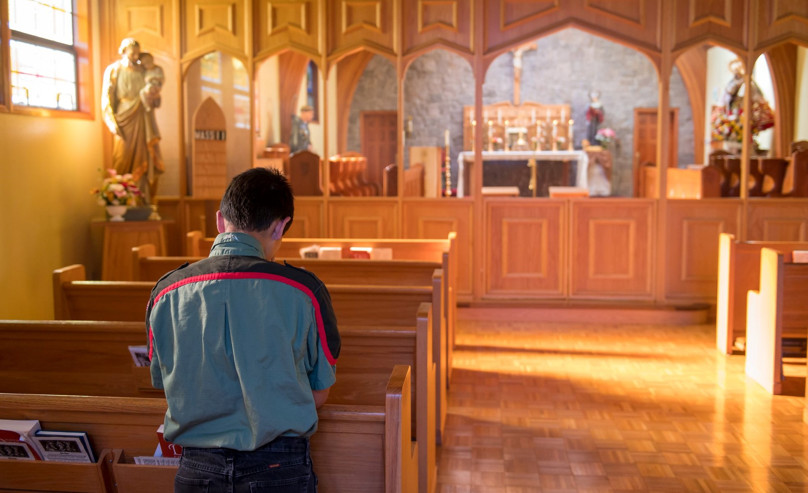
Blazing the Catholic Trail Trail Life Overview for Catholic Troops

Slide 2
What is Trail Life?
Traditional scouting methods:
Outdoor adventure
Ideals
Association with adults
Personal growth
Advancement
Patrol method
Leadership development
Uniforms
Trail Life adds:
Christian formation

Slide 3
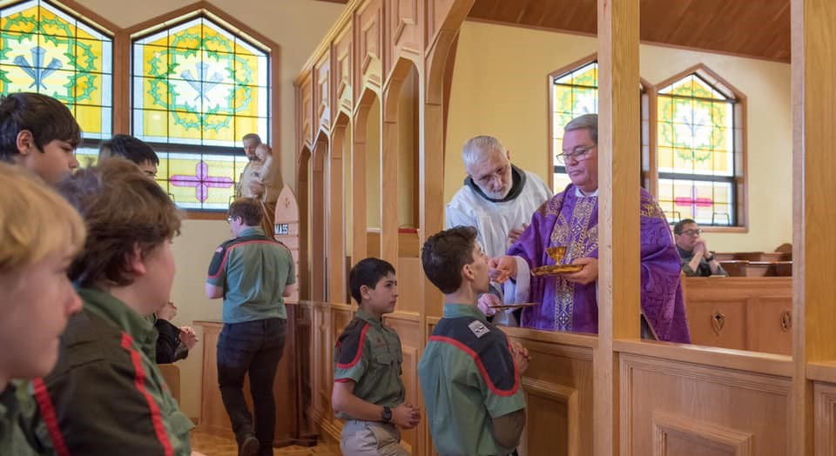
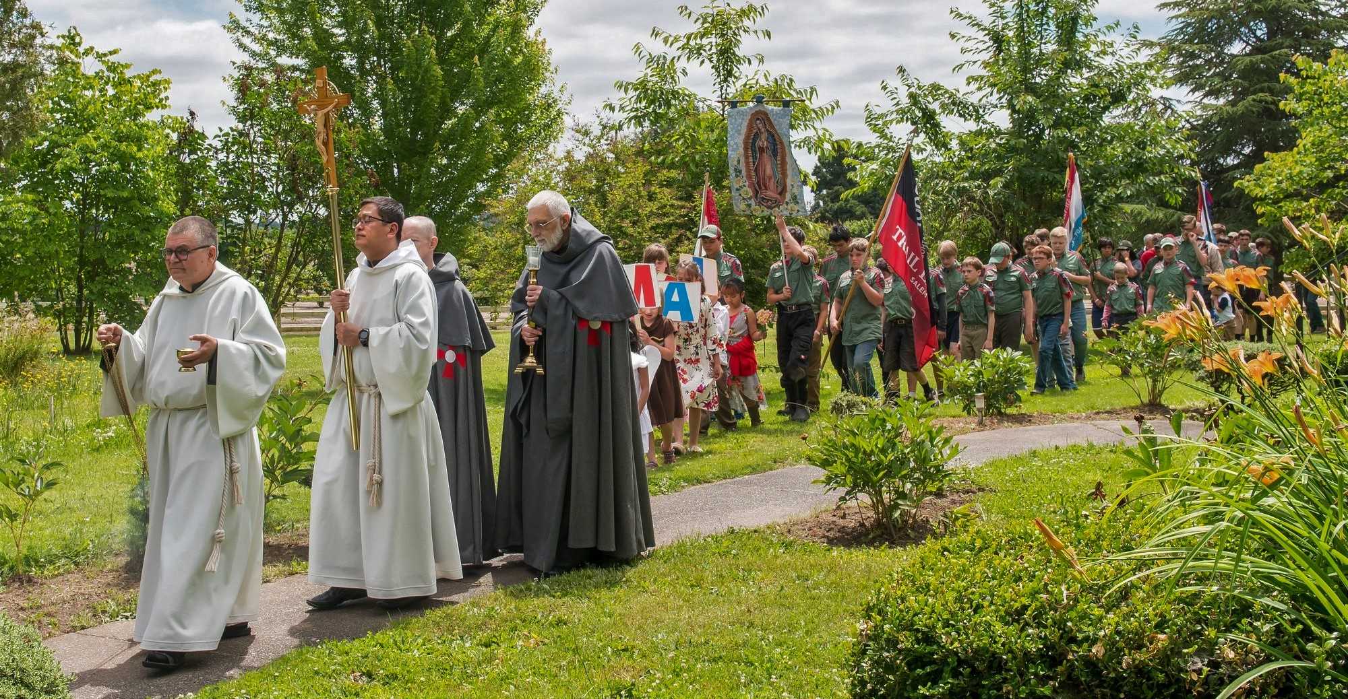
Trail Life’s Vision & Mission
Our Vision is to be the premier national character development organization for young men which produces godly and responsible husbands, fathers, and citizens
Our Mission is to guide generations of courageous young men to honor God, lead with integrity, serve others, and experience outdoor adventure

Slide 4
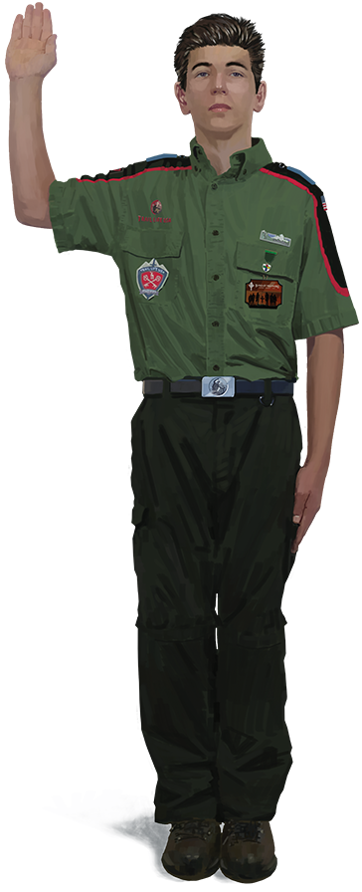
Trailman Oath & Motto
On my honor, I will do my best To serve God and my country; To respect authority; To be a good steward of creation; And to treat others as I want to be treated
Colossians 1:10 “… That you may walk worthy of God, in all things pleasing; being fruitful in every good work, and increasing in the knowledge of God:”

Slide 5
Trail Life aligned to the Transcendentals
Beauty
Goodness
Virtue
Truth
Discipleship
Fun
God’s creation
Community
Leadership development
Evangelization
Christian life
Outdoor adventure
Vocation

Slide 6
Trail Life Leads with Beauty
Truth
Goodness
Beauty
Begin with the splendor of God’s creation and the joy and peace of Christian life
Once attracted to beauty, there is greater openness to living the virtues
Increased holiness and sanctification from living the virtues makes one more receptive to the truth of the Gospel

Slide 7
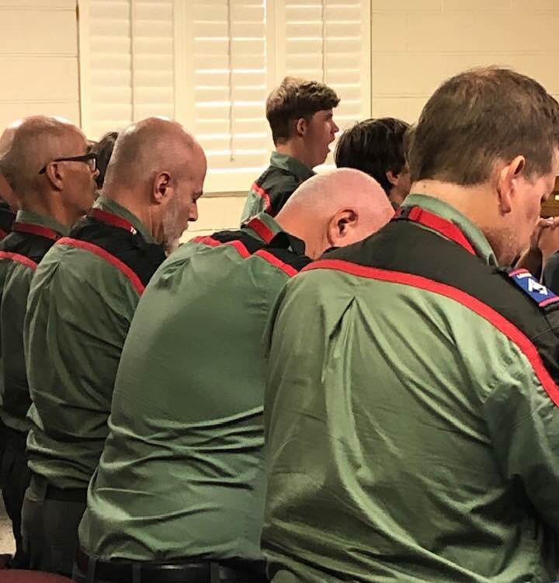
Statement of Faith (Adult Leaders)
We believe there is One Triune God—God the Father; Jesus Christ, His one and only Son; and the Holy Spirit—Creator of the universe and eternally existent. We believe the Holy Scriptures (Old and New Testaments) to be the inspired and authoritative Word of God. We believe each person is created in His image for the purpose of communing with and worshiping God. We believe in the ministry of the Holy Spirit, Who enables us to live godly lives. We believe each of us is called to love the Lord our God with all our heart, mind, soul, and strength, and to love our neighbors as ourselves. We believe God calls us to lives of purity, service, stewardship and integrity.

Slide 8
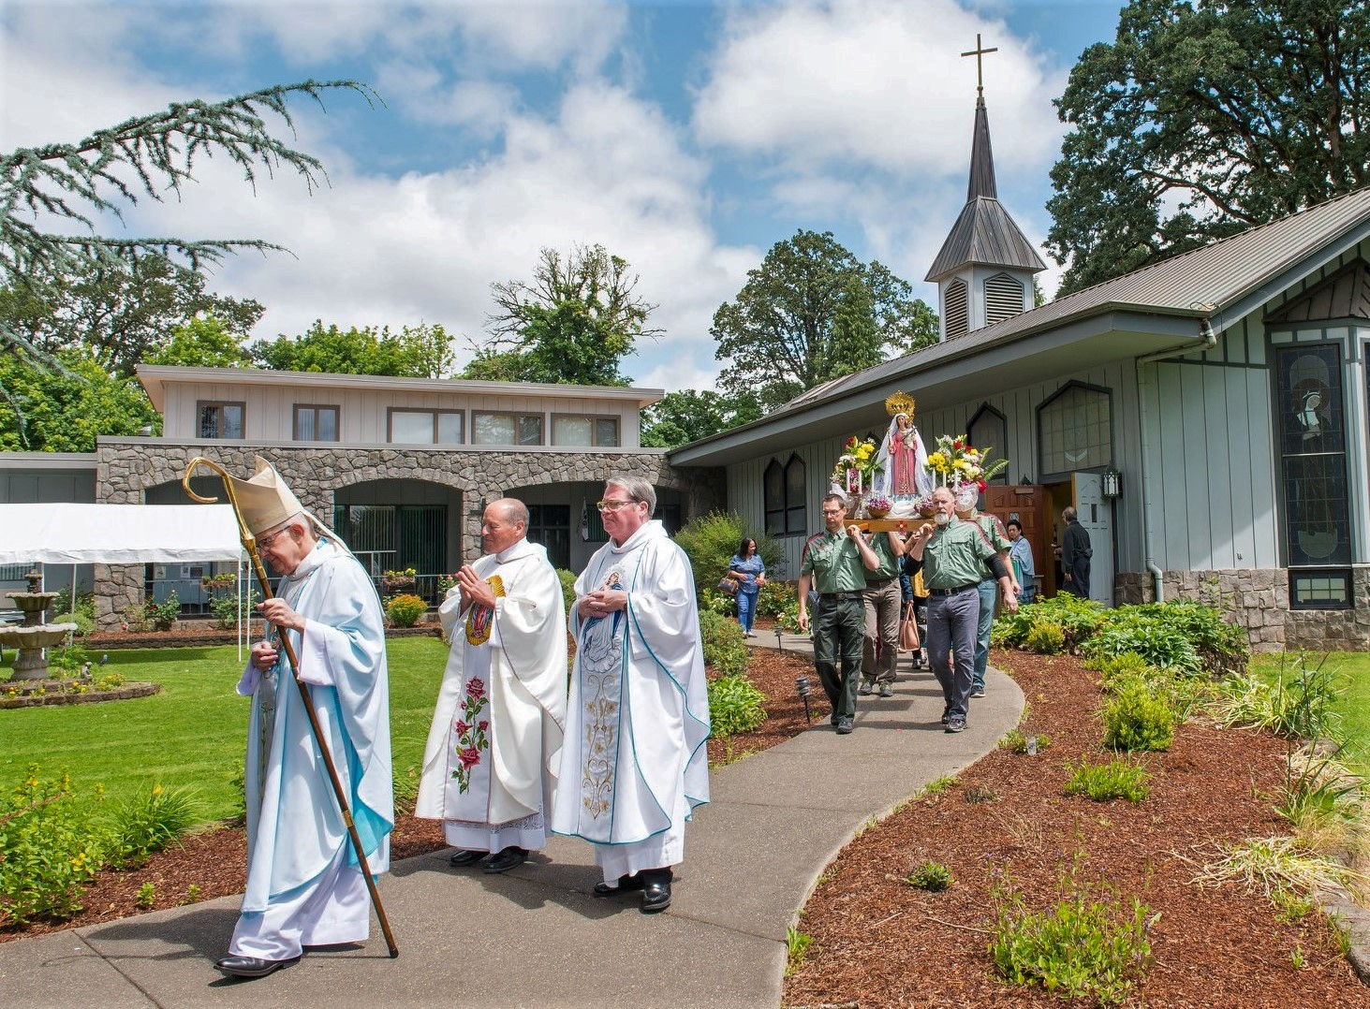
Statement of Values (Adult Leaders)
Purity—God calls us to lives of holiness, being pure of heart, mind, word and deed. We are to reserve sexual activity for the sanctity of marriage, a lifelong commitment before God between a man and a woman.
Service—God calls us to become responsible members of our community and the world through selfless acts that contribute to the welfare of others.
Stewardship—God calls us to use our God-given time, talents, and money wisely.
Integrity—God calls us to live moral lives that demonstrate an inward motivation to do what is biblically right regardless of the cost.

Slide 9
Program Levels
Troops are organized according to biblical principles in Proverbs 24:3-4, reflecting age appropriate (K-U-W-L) groups of boys:
Woodlands Trail (Knowledge)—Elementary School
Navigators (Understanding)—Middle School
Adventurers (Wisdom)—High School
Guidon (Life)—College and University
By wisdom a house is built,
by understanding it is established;
And by knowledge its rooms are filled with every precious and pleasing possession.
Proverbs 24:3-4

Slide 10
Woodlands Trail
Elementary-school age (ages 5-10), three 2-year programs:
Fox (Kindergarten-1st grade and 5 years old by October 31)
Hawk (2nd-3rd grade and 7 years old by October 31)
Mountain Lion (4th-5th grade and 9 years old by October 31)
Adult led, participation-based

Slide 11
Navigators
Middle-school age (ages 11-13)
Achievement-based, including skills, service, leadership, and faith formation
Boy led with strong adult guidance

Slide 12
Adventurers
High-school age (ages 14-18)
Achievement-based, including skills, service, leadership, and faith formation
Boy led with adult mentorship

Slide 13
Core Values of Trail Life
Christ-centered
Church-owned & Operated
Outdoor-focused
Safety
Courage
Male-centered Adult Leadership
Volunteer-driven
Program Flexibility
Shared Leadership
Youth-centered Leadership
Character-focused, Not Awards-focused
Servant Leadership
Family-oriented
Decentralized Decision-making
Debt Averse
Christian Worldview

Slide 14
Christ-centered
Our Lord Jesus Christ is central to all Trail Life activities and our mission of discipleship
Trail Life is boy-focused, so it is not Sunday school. We lead with fun and outdoor adventure but integrate faith into every aspect of the program.
Carrot cake metaphor. Nutritious carrots (faith) found in each bite, but sweet cake (fun and outdoor adventure) is what attracts boys to eat.

Slide 15
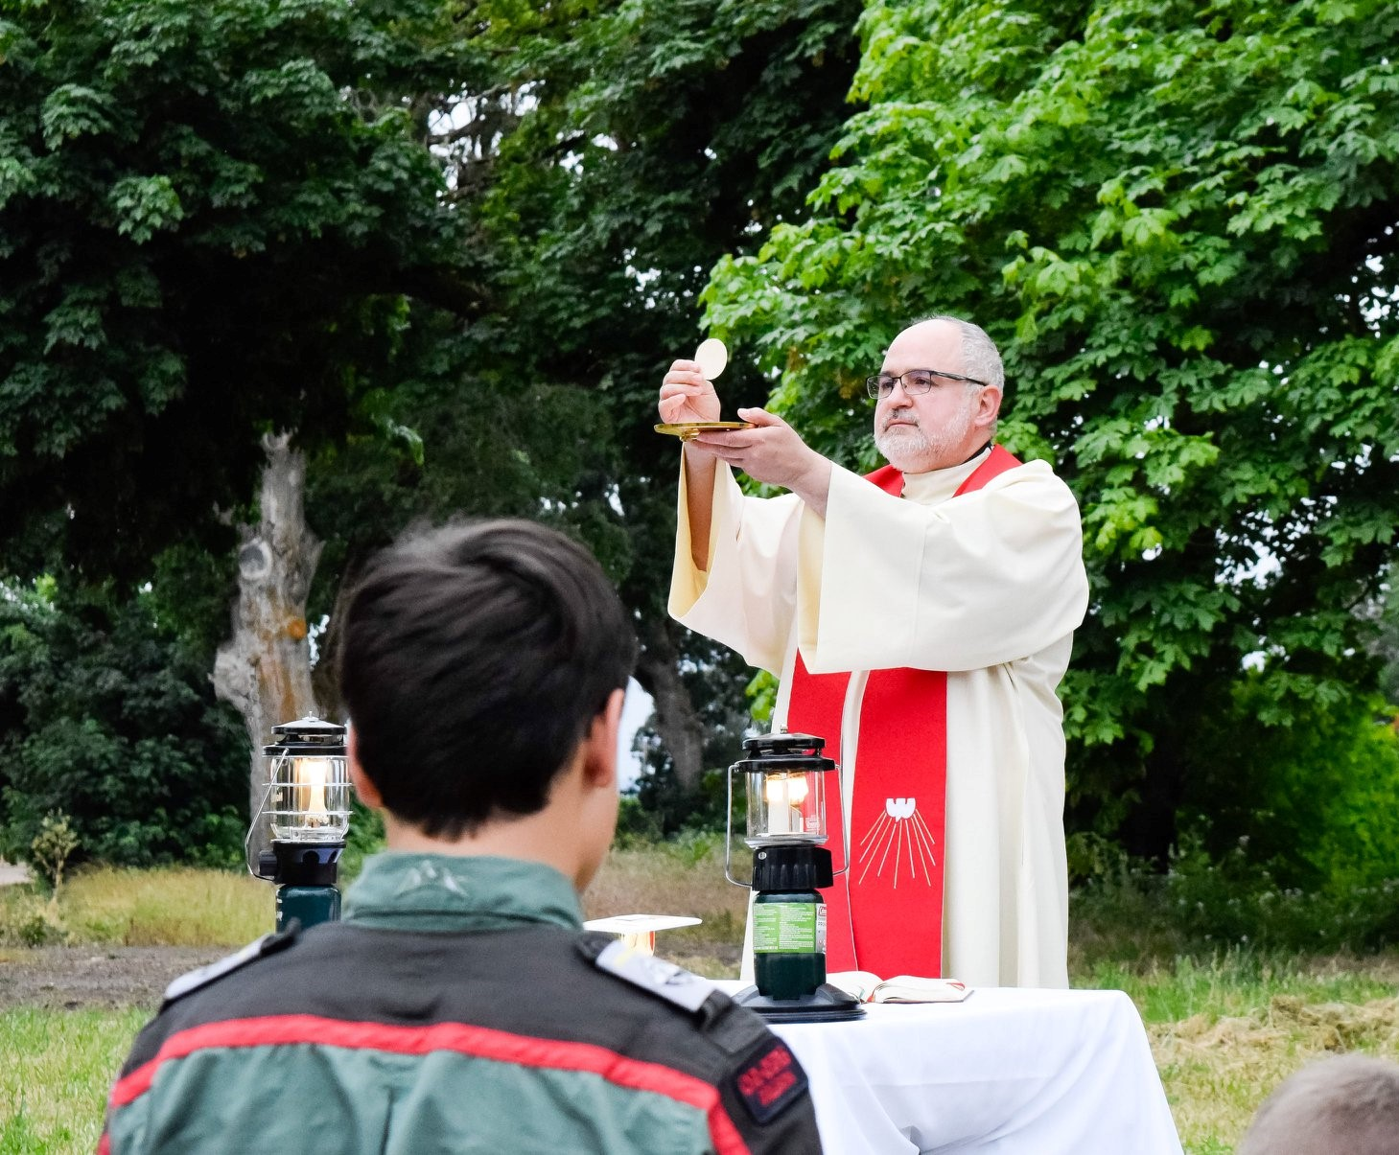
Outdoor-focused
The beauty of God’s creation—the outdoors—is the best setting for Trail Life
Trail Life is not school. Boys crave danger and adventure; they were designed to be active
Trail Life is about camping, hiking, boating, outdoor cooking, and other outdoor adventure
Trail Life believes that boys should be allowed to get dirty. We Let Boys be Boys!

Slide 16
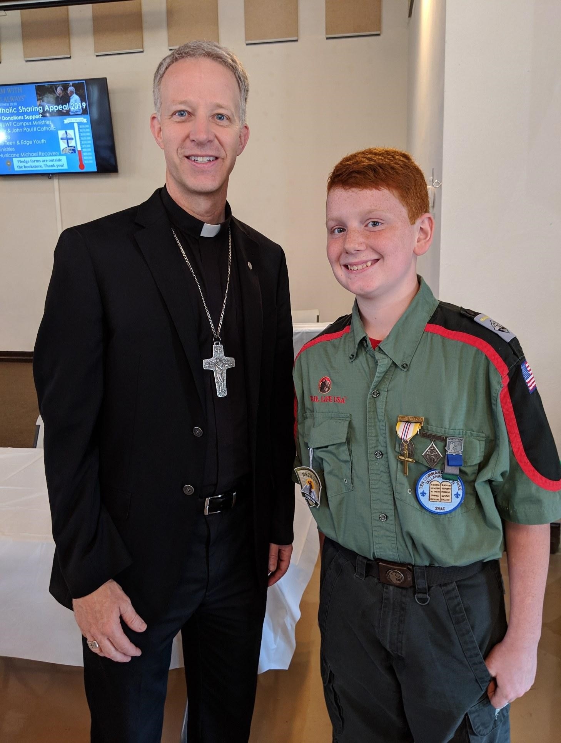
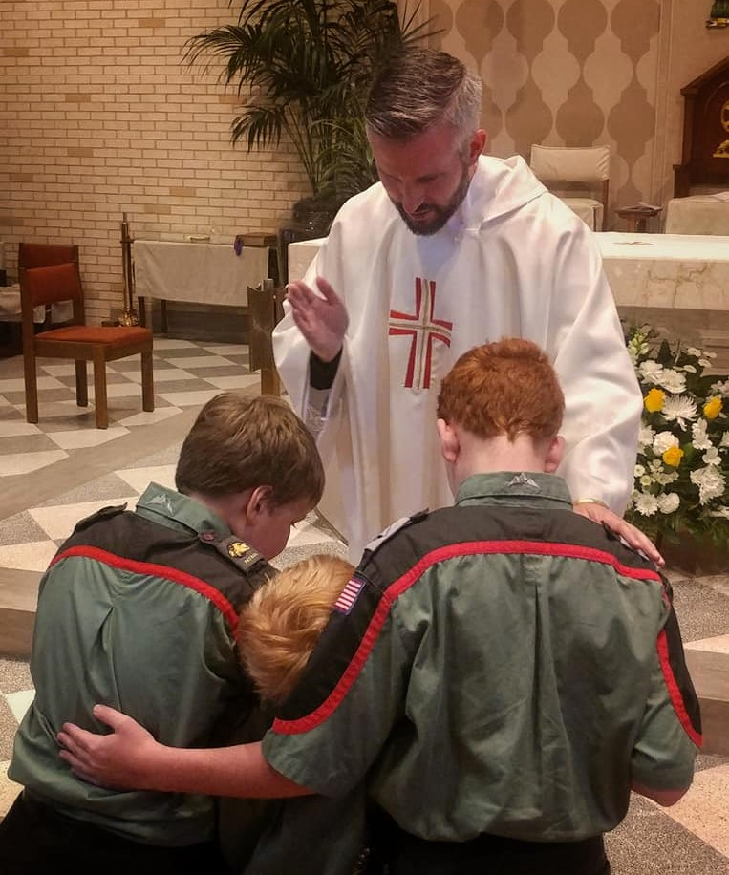
Church-owned & Operated
Troops fully integrated into life of parish
Troops receive spiritual guidance from pastor and other clergy
Diocese and parish ensure that the troop presents Catholic faith consistent with Sacred Scripture, Sacred Tradition, and Magisterium of the Catholic Church
Relationship between parish and troop should be much deeper than parish’s merely providing the troop with a place to meet

Slide 17
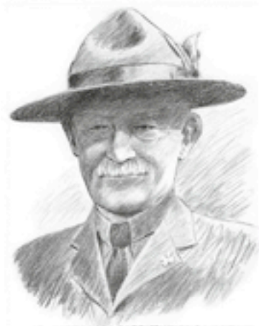
Youth-centered Leadership
Trail Life honors the legacy of Lord Baden-Powell’s international scouting movement:
“Scouting is nothing less than applied Christianity.”—BP
Patrol method and youth-centered leadership are essential to Trail Life
Trail Life seeks not only to produce tomorrow’s leaders, but Christian leaders who will become godly and responsible husbands, fathers, and citizens:
Strengthen the domestic church
Increase vocations to priesthood and religious life
Restore Christian worldview to our nation

Slide 18
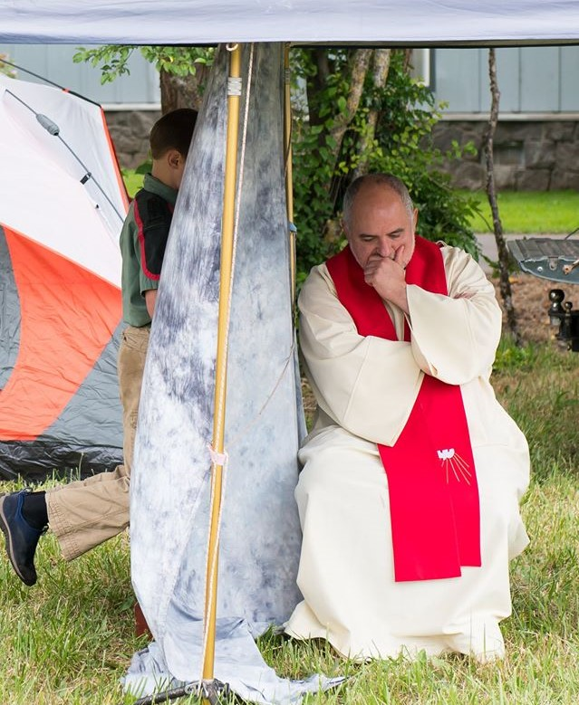
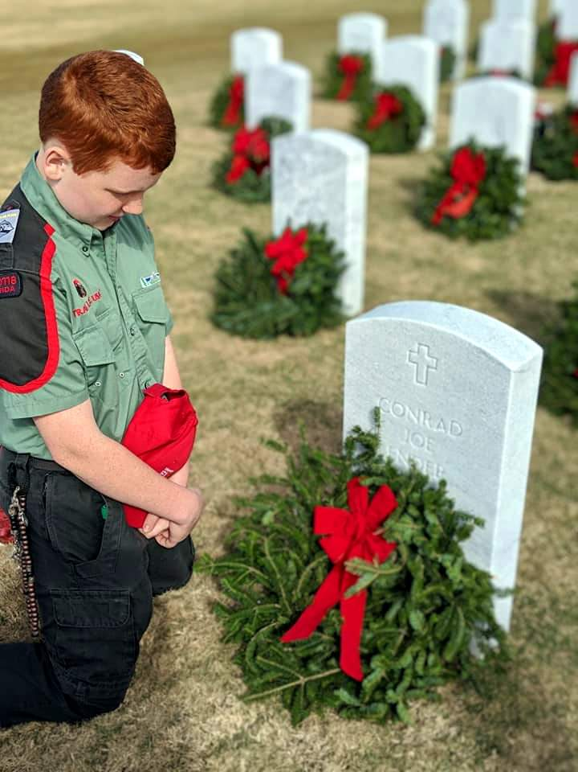
Character-focused, Not Awards-focused
Trail Life honors its scouting legacy but raises the standard
Trail Life acknowledges that recognition of boys’ achievements is important
Trail Life is more concerned with building character—habituating virtue and forming conscience—than awards
Trail Life’s highest award—the Freedom Award—cannot be earned before high school age after demonstrating maturity and leadership

Slide 19
Trail Life’s Catholic Efforts
National Catholic Committee
Focus: Policymaking and spiritual direction
Troops Fully Alive
Focus: Grassroots organization and implementation

Slide 20
Complementary Catholic Efforts
National Catholic Committee
National committee of laymen and clergy (both priests and deacons)
Includes Fr Shenan Boquet, who serves as Trail Life’s national Catholic chaplain
Ordinary is Bp Michael Burbidge of Arlington, VA
Episcopal advisory board includes Bp James Conley of Lincoln, NE; Bp David Kagan of Bismarck, ND; and Bp Michael Sheridan of Colorado Springs, CO
Troops Fully Alive
National association
Membership composed of Trail Life troops from parishes, Catholic schools, and other Catholic institutions and individual Catholic Trailmen
Ordinary is Bp William Wack of Pensacola-Tallahassee, FL

Slide 21
Complementary Catholic Efforts
National Catholic Committee
Official link between US hierarchy of Catholic Church (bishops) and Trail Life USA
Fosters relationships with bishops and US Conference of Catholic Bishops
Approves religious emblems programs
Oversees future diocesan committees
Troops Fully Alive
Shares best practices among Catholic troops
Coordinates development of program support materials
Helps develop authentic Catholic identity within Catholic troops
Promotes Trail Life in Catholic community
Coordinates Catholic multi-troop events, such as pilgrimages

Slide 22
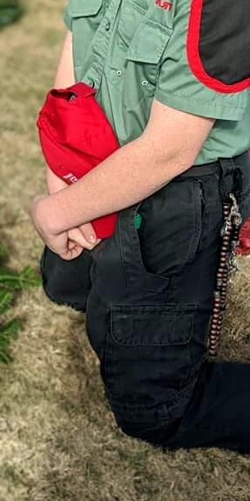
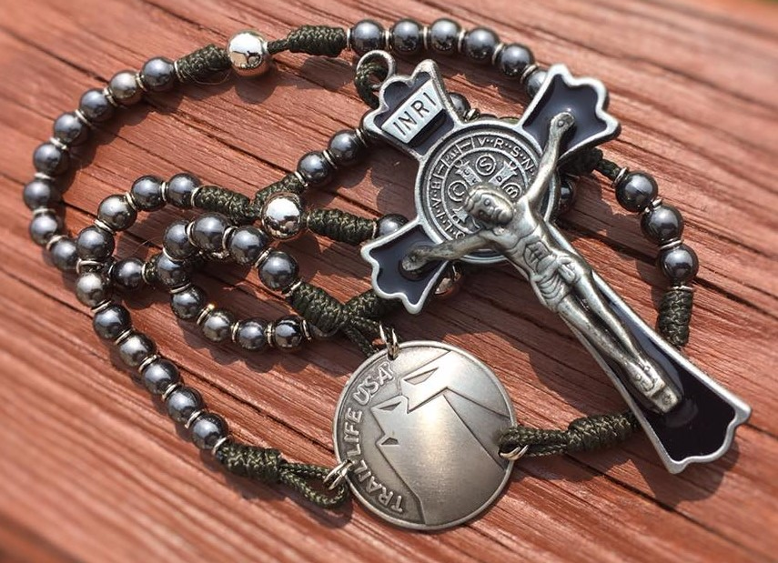
CATHOLIC IDENTITY IN TRAIL LIFE: Seven Pillars of the Christian Life

Slide 24
The national association of Trail Life’s Catholic troops
Copyright © 2021 by Troops Fully Alive, Inc. All Rights Reserved.

